Slide 1


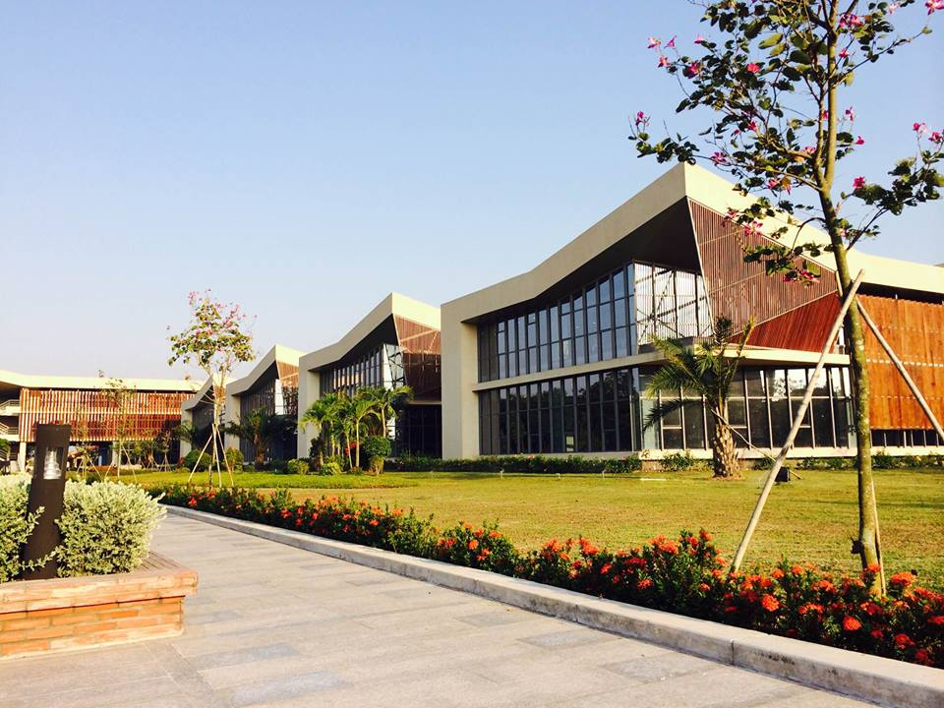
Re-Inspection
Report
By: nedd.phan
Date: June 2026

Slide 2

Re-Inspection Report_June 2026
Insp. times 337
Insp. times 898
Insp. times 561
TOP 5 COUNTRY AUDIT
TOP 5 MODEL AUDIT
TOP 5 DEFECT
VH
Model | % Fail
NIKE AIR WINFLO 12 (MS/WS) | 7,92%
JORDAN SPIZIKE LOW (GS) | 6,93%
NIKE SB FORCE 58 | 6,27%
AIR JORDAN 1 LOW SE (MS/WS) | 5,61%
JORDAN TRUE FLIGHT (MS) | 4,62%
Insp. times: 303
VH2
Model | % Fail
NIKE AIR MAX EXCEE (MS/WS) | 17,65%
NIKE UPLIFT SC (MS/WS) | 14,71%
NIKE RUN DEFY (MS/WS) | 11,76%
NIKE AIR WINFLO 12 GTX (MS/WS) | 11,76%
NIKE INITIATOR (MS/WS) | 8,82%
Insp. times: 34
Model | % Fail
NIKE EBERNON LOW (MS/WS) | 26,74%
NIKE INITIATOR (MS/WS) | 17,44%
NIKE AIR MAX MOTION 2 (MS/WS) | 15,12%
NIKE COURT BOROUGH MID (PSV) | 11,63%
NIKE AIR MAX SC (MS/WS) | 9,30%
JV
Insp. times: 86
Model | % Fail
NIKE COURT VISION LOW (MS/WS) | 20,21%
JORDAN 1 MID SE (PS/TD) | 11,16%
AIR JORDAN 1 MID SE (GS) | 10,53%
NIKE INITIATOR (MS/WS) | 8,42%
JORDAN 1 LOW ALT (PS) | 7,16%
JV2
Insp. times: 475

Slide 3
Re-Inspection Report_June 2026
COMPARISON OF THE TWO INSPECTIONS
BY
QC
 | Wrinkle bottom
 | Wrinkle collar lining
 | Rocking
 | Sole attachment
 | Collar shape
 | Heel/Tip height inconsistent
 | Bottom Cosmetic
 | Others
 | Components inconsistent
 | Nosew bond gap
 | Cleanness
 | Midsole/Outsole to upper bond gap
 | Over cement
 | Thread end
VH
BY
MA
BY
QC
At RED FRAME, We observed that after the Reinspection process, MA-Reinspection still detected Cleanness issues with no significant improvement in the number of defects compared to HFPA and QC-Reinspection
VH2
BY
MA
It is nescessary for Reviewing the inspection standards among QCs - MAs, as well as within each team themselves

Slide 4
Re-Inspection Report_June 2026
COMPARISON OF THE TWO INSPECTIONS
BY
QC
 | Cleanness
 | Midsole/Outsole to upper bond gap
 | Thread end
 | Over cement
 | Over buffing
 | Heel off center
 | Sole attachment
 | Bottom Cosmetic
 | Heel/Tip height inconsistent
 | Sockliner position
 | Toe off center
 | Paint peeled off
 | Rocking
JV
BY
MA
According to RED FRAME, we observed that top defects (Cleanness, Midsole/Outsole to upper bond gap) at FTT still detected by QC-reinspection with a significantly high number
At BLUE FRAME, despite having undergone the Re-ins process, defects detected by MA during HFPA (Over cement, Cleanness) were still repeated at the MA re-inspection with only slight improvement in quantity.
BY
QC
At PURPLE FRAME defects detected during HFPA (Over cement, Cleanness) had only slight improvement and even increased in quantity at the QC & MA re-inspection.
JV2
It is nescessary for Reviewing the inspection standards among QCs - MAs, as well as within each team themselves
BY
MA

Slide 5
THANK YOU!
nedd.phan@chingluh.com

